Slide 1
Abstract interpretation for the working programmer Lezione 3 – Concetti Avanzati
Francesco Logozzo
Microsoft Research, Redmond, WA, USA

Slide 2
Let’s recap
Analyze a method
Prove assertions
True
False
Bottom (unreached)
Top
Refine the analysis on Top
More refined abstract domain
Backward analysis
And if it fails???

Slide 3
Why are we getting Top?
Missing information
The analysis is modular
The program is sometimes wrong
Examples…

Slide 4
Example
public void IsOutOfBounds(int[] a)
{
int sum = 0;
for (int i = 0; i <= a.Length; i++)
{
sum += a[i];
}
}
Is it correct?
Is it always wrong?

Slide 5
Trace-based vs state-based
Clousot analysis is state-based
Over-approximate the set of states reaching a program point
Suppose a.Length == 5
public void IsOutOfBounds(int[] a)
{
int sum = 0;
for (int i = 0; i <= a.Length; i++)
{
sum += a[i];
}
}
{ i: 0, i: 1, i: 2, i: 3, i: 4, i:5 }
i : [0, 5]

Slide 6
More on state abstraction
Execution reaches the assertion5 times
Only one is definitely wrong
The abstraction does not distinguish it
Question: How can we refine it?
Why should we refine it?
Better error messages

Slide 7
Concrete trace semantics
Semantics of a program:
Sets of traces
Concrete states
Σ : [ Vars → Values ]
(assume de-heap)
Program counter pc ∈ Vars
Concrete semantics
Transition t
t ∈ [Σ → ℘(Σ)]
Ex. Why sets?

Slide 8
Partial traces semantics
Let Σ₀ set of initial states
Partial trace semantics
X = Σ₀ ∪ { τ σ_{i+1} |
τ = σ₀ σ₁ … σ_{i} ∈ X ∧ (σ_{i}, σ_{i+1}) ∈ t}
Semantics : Least fix point

Slide 9
For-loop unrolling
public void IsOutOfBoundsUnroll(int[] a)
{
int sum = 0;
for (int i = 0; i <= a.Length; i++)
{
if (i < a.Length)
{
sum += a[i];
}
else
{
sum += a[i];
}
}
}

Slide 10
Example
Fixpoint iterations
Suppose a = [1, 2, 3, 4]
At the whiteboard!

Slide 11
State based abstraction
Idea: group states by program point
It’s an abstraction!
α ∈ [Σ* → (PC → Σ)]
γ ?
In the example:
α (F)(2) = { (i:0, s:0), (i:1, s: 1), (i: 2, s: 3), (i: 3, s: 6), (i:4, s: 10) }
Strongest postcondition for a program point
Can be too strong!
Not computable ;-)

Slide 12
Inter-method Inference

Slide 13

Precondition inference
public int ZeroValues(int[] a)
{
int count = 0;
for (int i = 0; i < a.Length; i++)
{
if (a[i] == 0)
count++;
}
return count;
}

Slide 14
Precondition inference
Let assume we cannot prove:
assert exp
It may be that exp depends on the entry state
Th (?) : if exp
contains only variables of the prestate
fields, parameters
not modified in any path from the entry point to the assertion
Then exp is a precondition of the method

Slide 15
Hmmmm… 30 & lode?

Slide 16
Counter-example to “Theorem”
public int NotAPrecondition(object x)
{
if (x is string)
{
Contract.Assert(((string)x).Length > 10);
}
if (x is int[])
{
Contract.Assert(((int[])x).Length > 10);
}
return 0;
}

Slide 17
Pre-condition inference
Mainly an heuristic
“Suggested precondition:”
Precise inference requires WP calculus
Loops?
Necessary pre-conditions?
Easy
Most of the times get top
Sufficient pre-conditions?
Hard
Solved for fixed forms (template)

Slide 18
Post-condition inference

Slide 19
In theory
Have a method m
For each program point
Abstract state a
Approximate the concrete states at that point
Take the abstract state at the exit point of the method
public int Sum(int x, int y)
{
Contract.Requires(x >= 0);
Contract.Requires(y >= 0);
return x + (y - x) / 2;
}

Slide 20
In practice: Locals
Make no sense outside the method body
tmp+x is not a postcondition
tmp is not visible outside Local
public int Local(int x)
{
int tmp = … ; // some strange computation
return tmp + x;
}

Slide 21
In practice: Redundant info
int z;
public void Redundant(int x, int y)
{
Contract.Requires(x >= 0);
Contract.Requires(y >= 0);
z = x + y;
}
z >= 0
x >= 0
y >= 0
z = x + y
z <= x + y
z >= x +y
x <= z
y <= z
…
Infinitely many
equivalent expressions

Slide 22
In practice: Information split
public int Square(int x, int y)
{
return (x * x) - (y * y);
}
Quadratic postcondition
Need non-linear domain?
Info from the expression refinement domain

Slide 23
In practice: duplicated
public int Dup(int x, int y)
{
Contract.Requires(x >= 0);
Contract.Requires(y >= 0);
Contract.Ensures(Contract.Result<int>() >= 0);
return x + (y - x) / 2;
}
Postcondition is already there
No need to suggest/infer it again

Slide 24
The inference algorithm
For each abstract domain
Get a list of all the facts
Order the facts according an heuristic
Equalities > inequalities > ranges
Create the oracle O
α( “user-provided method postconditions “)
For each fact f
If O ⇒ f continue
Info already there
Else O = O ⊓ { f }
Emit O

Slide 25
Pre from post
Aka abductive inference
public int PreFromPost(int x)
{
if (x >= 0)
{
return -x;
}
throw new Exception();
}
x >= 0
Precondition or postcondition?

Slide 26

Object invariant inference

Slide 27

Class semantics
Execute the static constructor
Execute the object constructor
Forever
Execute one of the methods
Can be given a trace semantics
Th. Sound & Complete

Slide 28
Analysis
C1
C2
Cn
⊔
M1
M2
Mk
⊔

Slide 29
Example
public class Counter
{
private int c;
readonly int Max;
public Counter(int start)
{
this.c = 0;
this.Max = Int32.MaxValue;
}
public Counter(int c, int MaxValue)
{
Contract.Requires(MaxValue > 0);
this.c = 0;
this.Max = MaxValue;
}
public int Add()
{
c = c < Max ? c + 1 : 0;
return c;
}
}
0 <= c <= Max
0 <= Max <= Int32.MaxValue
c <= Max

Slide 30
Aliasing?
C1
C2
Cn
Context
⊔
M1
M2
Mk
Context
⊔

Slide 31
Can we do better?
Heuristic: If a field reference escape
Report a warning to the user
Assume it is not modified
Optimistic
Unsound!
Refine with contracts
Better: Approximate the context
Lose some modularity
(not today…)

Slide 32
Message prioritization

Slide 33
So we have a Top…
We should report it to the programmer
It can be:
a real bug?
a false positive?
In general impossible to tell
Undecidability of the analysis
Should sort all the messages
The one most likely to be bugs at the top

Slide 34
1. Warning partitioning
Partition warnings in classes
Contract violation
Non-null
Arrays
Overflows
…
Assign a fixed reward R to each class
R ∈ [ C → N ]
The highest the reward the more important

Slide 35
2. Scale rewards with outcome
False = 1.0 * R(c)
Important
Always wrong…
Bottom = 0.75 * R(c)
Unreached, we wanted it?
Top = 0.50 * R(c)
So many …
True = 0 * R(c)
Don’t care

Slide 36
3. Scale rewards with info
Proof obligation p contains
Variables from parameters
Variables result of a method call
…
The scale the reward
public foo(int z)
{
// ...
Contract.Assert(z + x > 0);
var f = Add();
Contract.Assert(f != null);
// ...
}

Slide 37
Heuristic…
Yep, it’s an heuristic
Is it the best one?
I do not know….
Can we do something more formal?
Assign a reward to each
Transfer function
Domain operation

Slide 38
Floating points…

Slide 39
Computers & numbers
Computers crunch numbers
But computer numbers are not mathematical ones!
Plethora of Int*
Int8, Int16, Int32, Int64, BigInt
UInt8, UInt16, UInt32, UInt64
And even more fun:
Floating points

Slide 40
Y > 0 ⇒ X + Y > X?
True: Epsilon != 0
Contract.Assert(Double.Epsilon != Double.Epsilon * Double.Epsilon);
Contract.Assert(1.0d == 1.0d + Double.Epsilon);
Contract.Assert(1000000000d == 1000000000d + Double.Epsilon);
True!

Slide 41
(x + k) – (x – k) == 2 k ?
double x, y, z, r;
x = 1.000000019e+38d;
y = x + 1.0e21d;
z = x - 1.0e21d;
r = y - z;
Contract.Assert(r == 2.0e21d);
Assert is false!

Slide 42
K ≠ 0 ⇒ (x + k) – (x – k) ≠ 0
double x, y, z, r;
x = 1.000000019e+38d;
y = x + 1.0e21d;
z = x - 1.0e21d;
r = y - z;
Contract.Assert(r == 0.0d);
Assert is true!

Slide 43

Solution? Static analysis
Error
Have intervals of doubles
For each operation
X op Y = [ inf(X op Y), sup (X op Y)]
Symbolic reasoning?
More complex
Done for some abstract domains
Octagons
Polyhedra
Linear Equalities

Slide 44
X == X ?
Assert is true!
Contract.Assert(0.0 == 0.0);
Contract.Assert(Double.NegativeInfinity == Double.NegativeInfinity);
Contract.Assert(Double.NaN == Double.NaN);
Assert is false!!!!!!!
1/0 is NaN
Sqrt(-1) is NaN

Slide 45
X == X ?
public class Point
{
public double X, Y;
Point(double x, double y)
{
this.X = x;
this.Y = y;
}
}
public CreatePoint(double x)
{
var p = new Point(x, x);
Contract.Assert(x == p.X);
}
Assert is false!!!!!!!

Slide 46
Why?
A double is a synonym for Float64
A Float64 is represented
in RAM with 64 bits
in the CPU with 80 bits!!!
RAM
32 bits
32 bits
32 bits
32 bits
CPU
80 bits

Slide 47
Cod-gen matters…
Compiler chose where to put variables
In the registers => Extra precision
Why? Additional precision matters for
Scientific computations
Games
…
A mess for static analyses!
In C/C++, depends on compiler/platform
In Java “strictfp” keyword
In .NET?

Slide 48
.NET ECMA standard
Allows
Locals
parameters
return value
To have the maximum precision
Requires
Fields
Globals
To be stored in memory
Ex: why?

Slide 49
Exercise: Static analysis?
public class Point
{
public double X, Y;
Point(double x, double y)
{
this.X = x;
this.Y = y;
}
}
public CreatePoint(double x)
{
var p = new Point(x, x);
Contract.Assert(x == p.X);
}

Slide 50
Arrays

Slide 51
Inferring array contents…
public void Init(int N)
{
Contract.Requires(N > 0);
int[] a = new int[N];
int i = 0;
while (i < N)
{
a[i] = 222;
i = i + 1;
}
Contract.Assert(∀ k ∈ [0, N). a[k] == 222);
}
Challenge 1:
Effective handling of disjunction
If i == 0 then
a not initialized
else if i > 0
a[0] == … a[i] == 222
else
impossible
Challenge 2:
No overapproximation (can be unsound)
(no hole, all the elements are initialized)

Slide 52
Not the first …
Many approaches using:
Human help
Under- and over-approximations
Templates
Theorem provers
…
We tried some in Clousot but not practical
Many hidden hypotheses
Scalability is an issue

Slide 53



Our idea
Precise and very very fast!
Basis: Array segments
Segment bounds
Disjunction
Uniform content abstraction
0
[222, 222]
i, k
?
[0, 0]
N
0 ≤ i, 0 ≤ k
i == k
i < N, k < N

Slide 54
Example
Contract.Requires(N > 0);
int[] a = new int[N];
0
0
N
int i = 0;
0,i
0
N
0
222
1,i
0
N
?
assume i ≥ N
assume i < N
i -> _
j -> i
N -> N
0,i
0
N
a[i] = 222;
0,i
222
1,i+1
0
N
?
j = i+1;
0,i
222
1,i+1,j
0
N
?

Slide 55
Segment unification
0,i
0
N
0
222
1,i
0
N
?
0
⊥
i
?
0
N
0
222
1,i
0
N
?
0
⊥
i
?
0
N
0
222
i
0
N
?
Join
Can be empty segments! (Disjunction)
0
222
i
?
0
N
?

Slide 56
Example
Contract.Requires(N > 0);
int[] a = new int[N];
int i = 0;
0
222
i
?
0
N
?
Remove doubts
(i == N && N > 0)
assume i ≥ N
assume i < N
0
222
i
?
0
N
0
222
i, N
a[i] = 222;
i -> _
j -> i
N -> N
And so on up to a fixpoint …
We visited all the elements in [0, N)
j = i+1;

Slide 57
Status…
Fast and precise array analysis
Implemented in Clousot
On mscorlib.dll:
Inferred 2429 non-trivial array properties
5 seconds slow down

Slide 58
JavaScript atomic type inference

Slide 59
Javascript…
The most widespread language in the world
Almost in every WEB page
Everywhere
WEB Browsers
Acrobat Reader (!)
Flash
….
Highly dynamic scripting language
No static type system
Add/remove fields at runtime
Object-oriented
But not class based
Unlike C++, C#, Java

Slide 60
Atomic types
function bitsinbyte(b) {
var m = 1, c = 0;
while (m < 0x100) {
if (b & m) c++;
m <<= 1;
}
return c;
}
function nestedLoops() {
var i, j;
for (i = 0; i < 10000; i++)
for (j = 0; j < i; j++) {
// do nothing...
}
}
No type declaration
No type checking
Double only numerical type in JavaScript
Are i, j doubles?
Are m, c, b doubles?

Slide 61
JavaScript runtime
Cannot be compiled (efficiently)
Because of the dynamic nature
Fully interpreted solution
Very expensive!
In dynamic languages values are boxed
Pair < Type, Value >
Ex
if(i.TypeCode == double)
{
var value = i.Value;
newValue = value + 1;
i = new Box(double, newValue);
}
else
{
ReportError();
}
}
i++
Runtime

Slide 62
Boxing
Kills performance
Example….
function nestedLoops() {
var i, j;
for (i = 0; i < 10000; i++)
for (j = 0; j < i; j++) {
// do nothing...
}
}

Slide 63
(Modern) Runtime
Just in time compiler (JIT)
Start interpreting the code
If Call f(… )
Check if f(…) in cache f’
Execute f’(…)
Else
Specialize f’ for its actual parameters
Compile f’(…)
Cache f’(…)
Execute f’(…)
…
JIT policies, kinds, … not today
Static analysis

Slide 64
Static analysis to avoid boxing
First idea: infer numerical values
Text book type inference
It’s an improvement, but yet not so big
Double are more expensive than ints
64 vs 32 bits, floating point, …
function nestedLoops() {
var i, j;
for (i = 0; i < 10000; i++)
for (j = 0; j < i; j++) {
// do nothing...
}
}
Doubles

Slide 65
Best: infer int?
Should preserve the semantics
Overflows
Divisions
NaN
…
Int
function Loop() {
var i;
for (i = 0; i < 100; i++) { }
}
function Loop() {
var i;
for (i = 0; i < 1000000000000; i++) { }
}
Doubles
function Loop() {
for (i = 0; i < 100; i++) { }
}

Slide 66

Variable range matters
Classical type inference do not work
Need more precise analysis
Abstract interpretation!
Concrete domain: PowerSet of
Abstract domain: Augmented Intervals

Slide 67
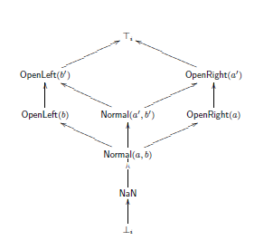
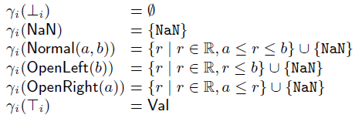
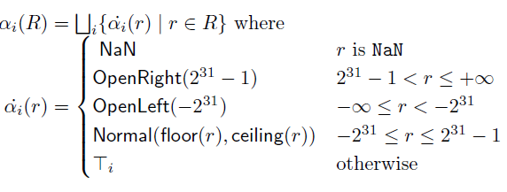
Augmented Intervals

Slide 68
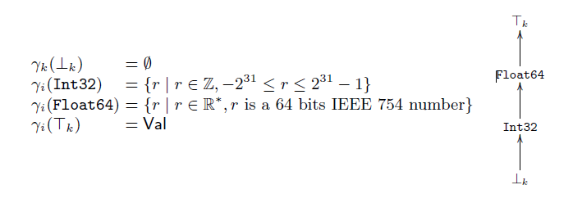
Kinds
function div() {
var z = 1 / 2;
return z;
}
Need to trace if non-int value
E.g. 0.5

Slide 69
Variation analysis
function bitsinbyte(b) {
var m = 1, c = 0;
while (m < 0x100) {
if (b & m) c++;
m <<= 1;
}
return c;
}
Need relation between m and c
Octagons, …. Too expensive at runtime!
Solution Variation analysis
m is in [0, 0x100]
c is in [0, +oo]
“c grows slower than m”
Ergo, m is in [0, 0x100] too

Slide 70
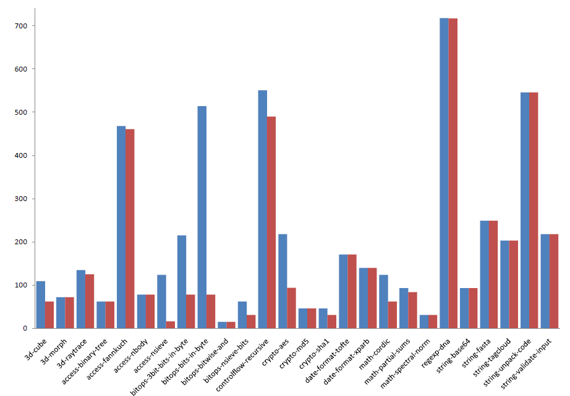
Results

Slide 71
The end!

Slide 72
Recap
CodeContracts
Specify contracts with code
Preconditions, postconditions, object invariants
Clousot
Language agnostic static checker
Based on abstract interpretation
New numerical domains
New array domain
Pre/Post/Obj Inv Inference

Slide 73
Javascript
Slow yet widespread language
Aggressive static analyses improve performance
A lot to do though

